Slide 1
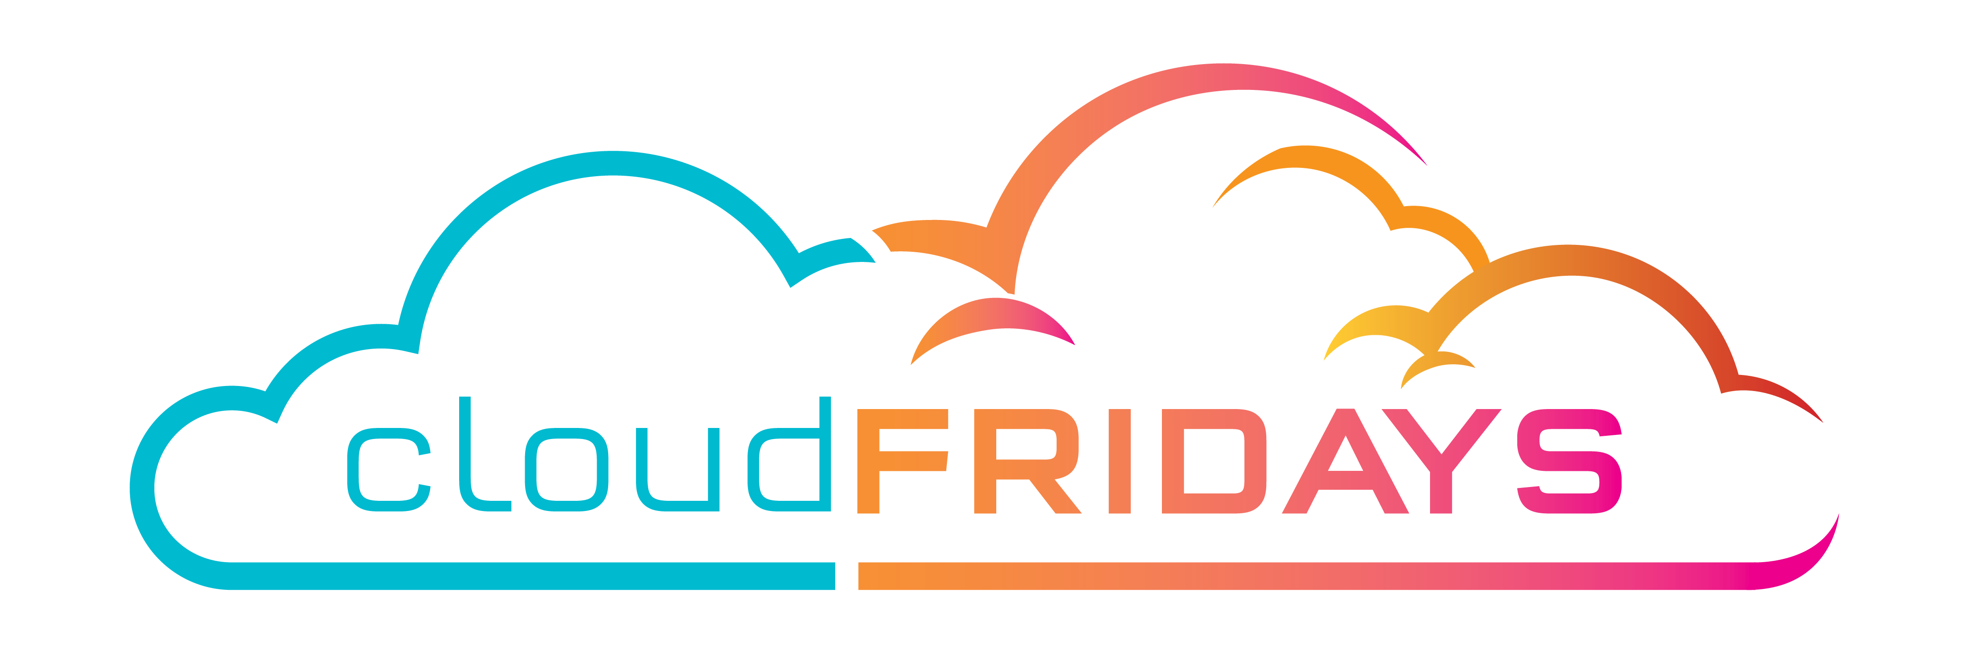

Public, Private and Hybrid
The differences between Public, Private and Hybrid cloud models
Warren du Toit & Matthew Levy
Azure MVP & Enterprise Mobility MVP

Slide 2
Agenda
Cloud definition
Public cloud
Private cloud
Hybrid cloud
Cloud model comparison
Summary

Slide 3
Cloud Definition
Service
Servers
Storage
Databases
Networking
Software
Analytics
AI
Features
HA
Scalability
Elasticity
Agility
Fault tolerance
Disaster recovery
Reach
Security
Notes:
Cloud services is a big shift from the traditional way businesses think about IT resources.
Benefits of the cloud
What are the benefits of cloud?
Time
Confidence
Performance

Slide 4
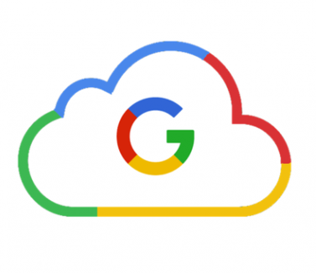

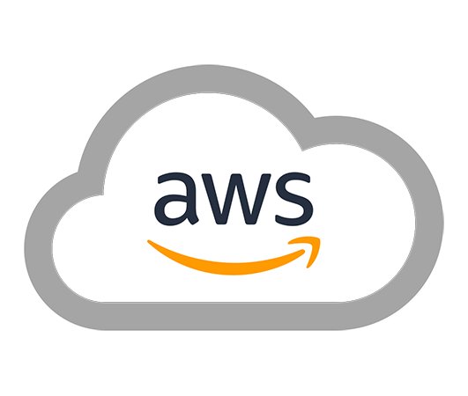
Public Clouds
Notes:
A public cloud is owned by the cloud services provider (also known as a hosting provider). It provides resources and services to multiple organizations and users, who connect to the cloud service via a secure network connection , typically over the internet.
Ownership: The resources do not belong to the organisation or user utilizing them, rather the third-party provider
Multiple End users: Available to multiple organisations or users
Public access:
Availability: Most common deployment model
Connectivity: Typically over the internet
Skills: Do not require deep technical knowledge to setup or use the services
In some cases, cloud users can save additional costs by sharing computing resources with other cloud users.
Common Use case:
Website or blog – user or organisations don’t have to worry about maintaining or managing hardware

Slide 5
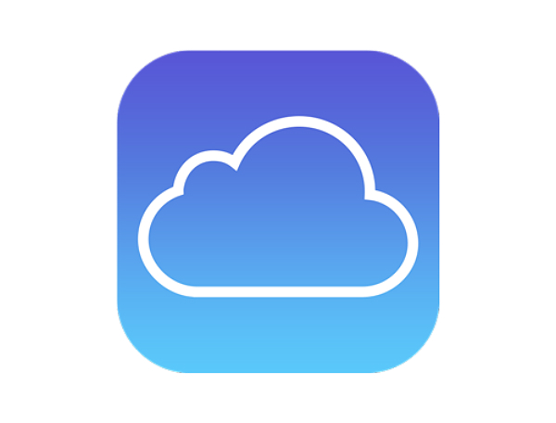


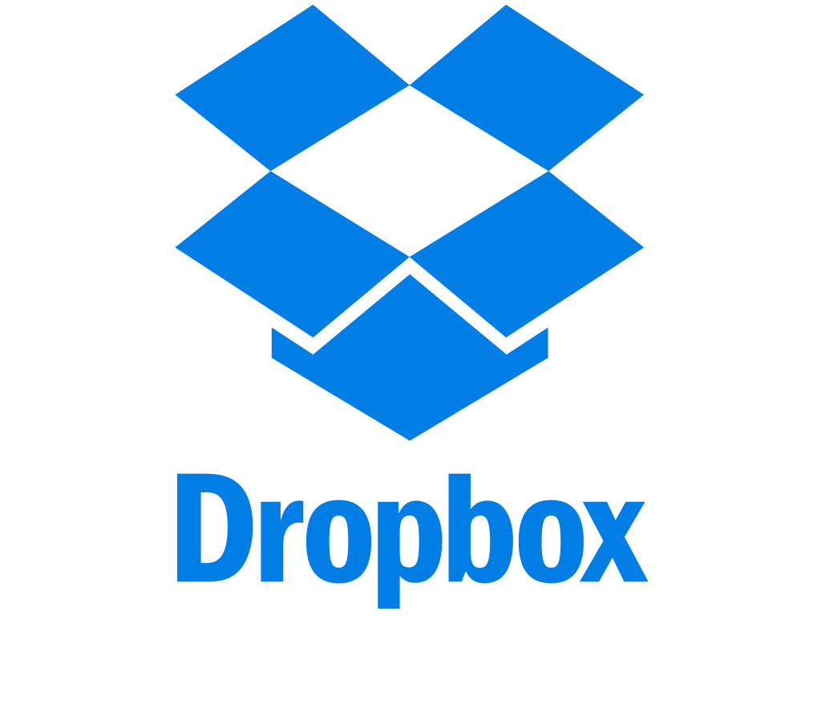

Other public clouds
Notes:
These are some examples of other public clouds.
Eskom is in there as an example of a utility provider which public clouds could be compared to. Discuss how Eskom could be like a public cloud.
With a public cloud, there is no local hardware to manage or keep up to date; everything runs on the cloud provider’s hardware.

Slide 6
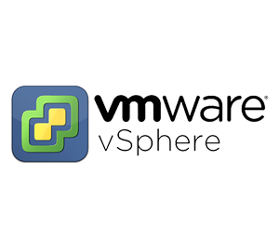
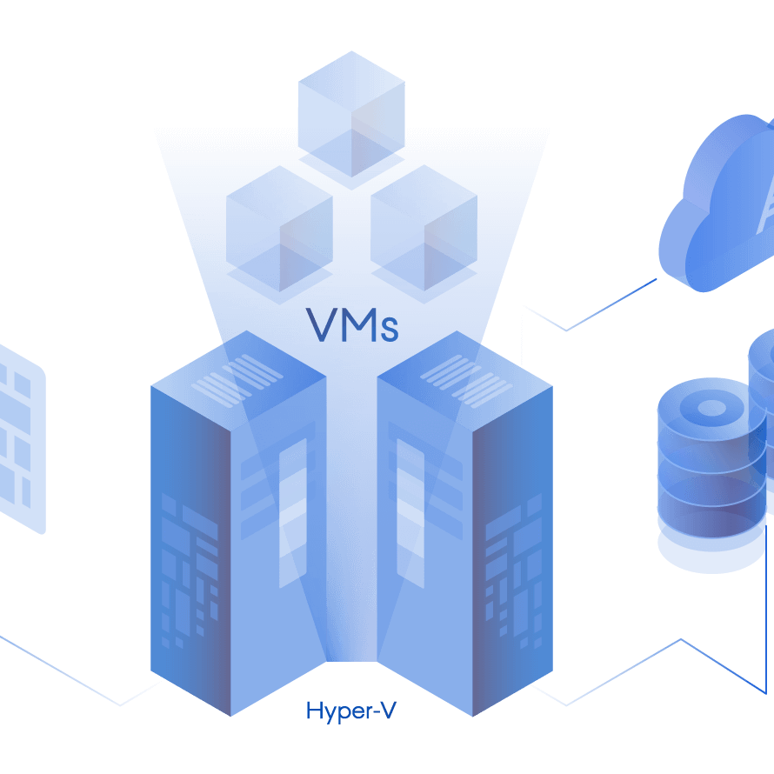
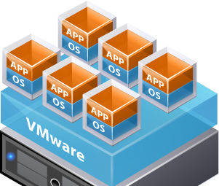
Private Cloud
Notes:
A private cloud is owned and operated by the organization that uses the resources from that cloud. They create a cloud environment in their own datacenter, and provide self-service access to compute resources to users within their organization. The organization remains the owner, entirely responsible for the operation of the services they provide.
Ownership: The owner and the consumer of the services are the same.
Hardware: The owner is responsible for the purchase, maintenance and management of all the hardware in the service
Users: Resources are used exclusively by a single organision or business
Connectivity: Typically over a secure private network
Public access: No public access
Skills: Requires deep technical knowledge to setup, manage and maintain.
A private cloud can provide cloud functionality to external customers as well, or to specific internal departments such as Accounting or Human Resources.
Common use case:
An organization has data that cannot be put in the public cloud, perhaps for legal reasons. For example, they may have medical data that cannot be exposed publicly.

Slide 7

Public Cloud
Private Cloud
Hybrid Cloud
Notes:
A hybrid cloud combines both public and private clouds, allowing you to run your applications in the most appropriate location.
Resource location: Specific resources are in public cloud, other resources are in private cloud
Cost and efficiency: hybrid model allows organisations to benefit from the cost, efficiency and scale that are available with public clouds yet retain management control of resources in private cloud.
Skill: Technical skills are still required to maintain private cloud and ensure both clouds can operate together.
An example of a hybrid cloud usage scenario would be hosting a website in the public cloud and linking it to a highly secure database hosted in a private cloud.
Another example is one or more applications that run on old hardware that can’t be updated. In this case, you can keep the old system running locally in your private cloud, and connect it to the public cloud for authorization or storage.

Slide 8
Cloud model comparison
Public Cloud
Advantages:
No CapEx
Agility
Consumption based model
Maintenance
Skills
Disadvantages:
Security
Compliance
Ownership
Specific requirements
Private Cloud
Advantages:
Control
Security
Compliance
Specific requirements
Disadvantages:
Upfront CapEx
Agility
Maintenance
Skills
Hybrid Cloud
Advantages:
Flexibility
Costs
Control
Security
Compliance
Specific requirements
Disadvantages:
Upfront CapEx
Costs
Skills
Ease of management

Slide 9
Session Summary
Spoke about public cloud, private cloud, and hybrid cloud models.
What the key characteristics of each model are.
How they compare.
What considerations you need to take into account when using them, and when you might use them.

